Slide 1
Multivariate models

Slide 2
Multivariate Ornstein-Uhlenbeck models
(Bartoszek et al. 2012; 2024; Reitan et al. 2012; Clavel et al. 2015; Voje 2023)

Slide 3
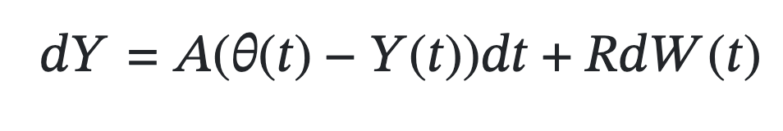
Multivariate Ornstein-Uhlenbeck models
(Bartoszek et al. 2012; 2024; Reitan et al. 2012; Clavel et al. 2015; Voje 2023)

Slide 4
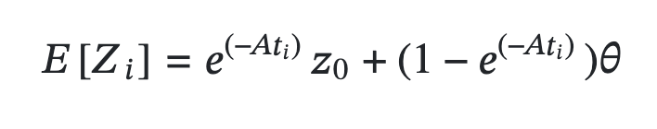
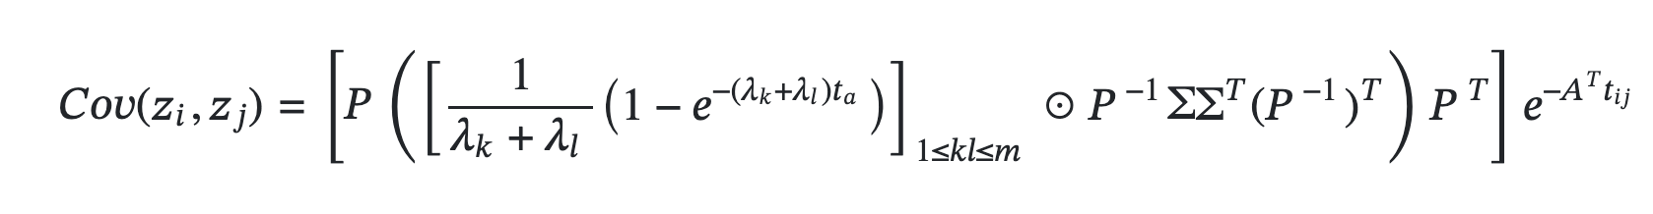
Multivariate Ornstein-Uhlenbeck models
(Bartoszek et al. 2012; 2024; Reitan et al. 2012; Clavel et al. 2015; Voje 2023)

Slide 5
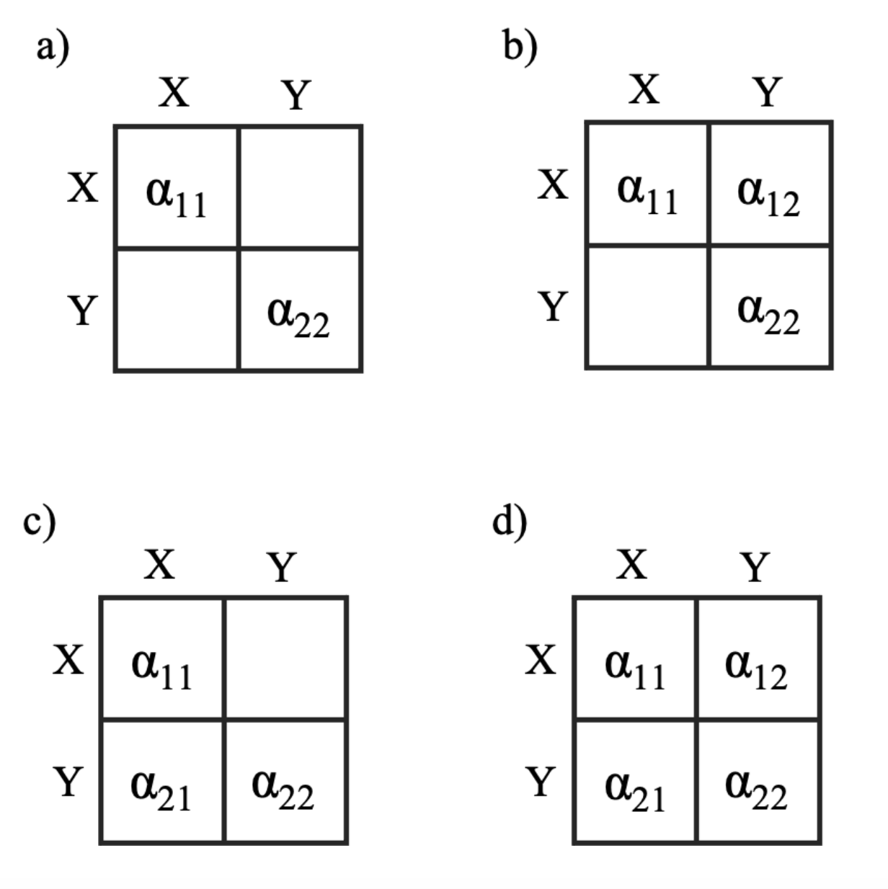

Slide 6
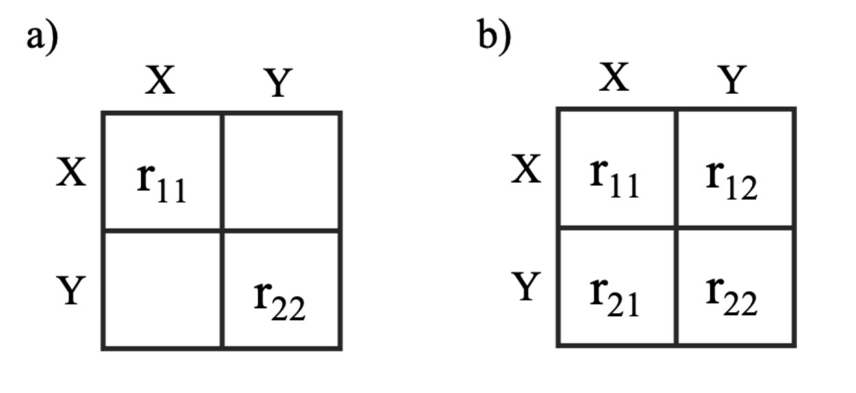

Slide 7
R =
Two traits evolving independently and uncorrelated

Slide 8
R =
Two traits showing correlated evolution

Slide 9
A =
R =
Two traits adapting independently towards separate optima, showing correlated evolution in the non-adaptive part of the trait dynamics.

Slide 10
A =
R =
One trait affecting the optimum of the other trait, while no correlated evolution in the non-adaptive part of the trait dynamics.

Slide 11
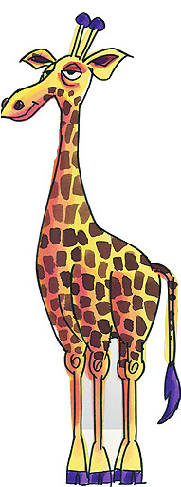

Optimal regression
Neck length
Height of trees

Slide 12
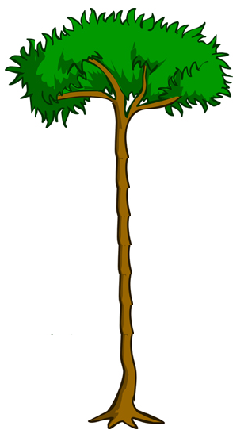
Optimal regression
Neck length
Height of trees

Slide 13
Optimal regression
Neck length
Height of trees

Slide 14
Optimal regression
Neck length
Height of trees

Slide 15
Optimal regression
Neck length
Evolutionary regression
Height of trees

Slide 16
Optimal regression
Neck length
Evolutionary regression
Height of trees

Slide 17
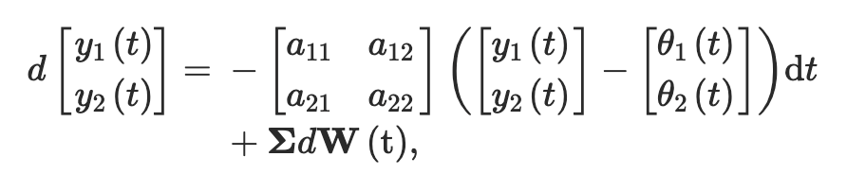

Slide 18
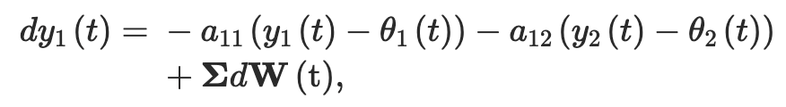

Slide 19
